Slide 1

EarWorm
COMP 490/L, Professor Dantes, 09/08/2022

Slide 2

Team Members
Charles Quebral
Mitchell Mercer
Nathalie Tivar
Alvaro Lopez-Romero
Rodolfo Rivera

Slide 3
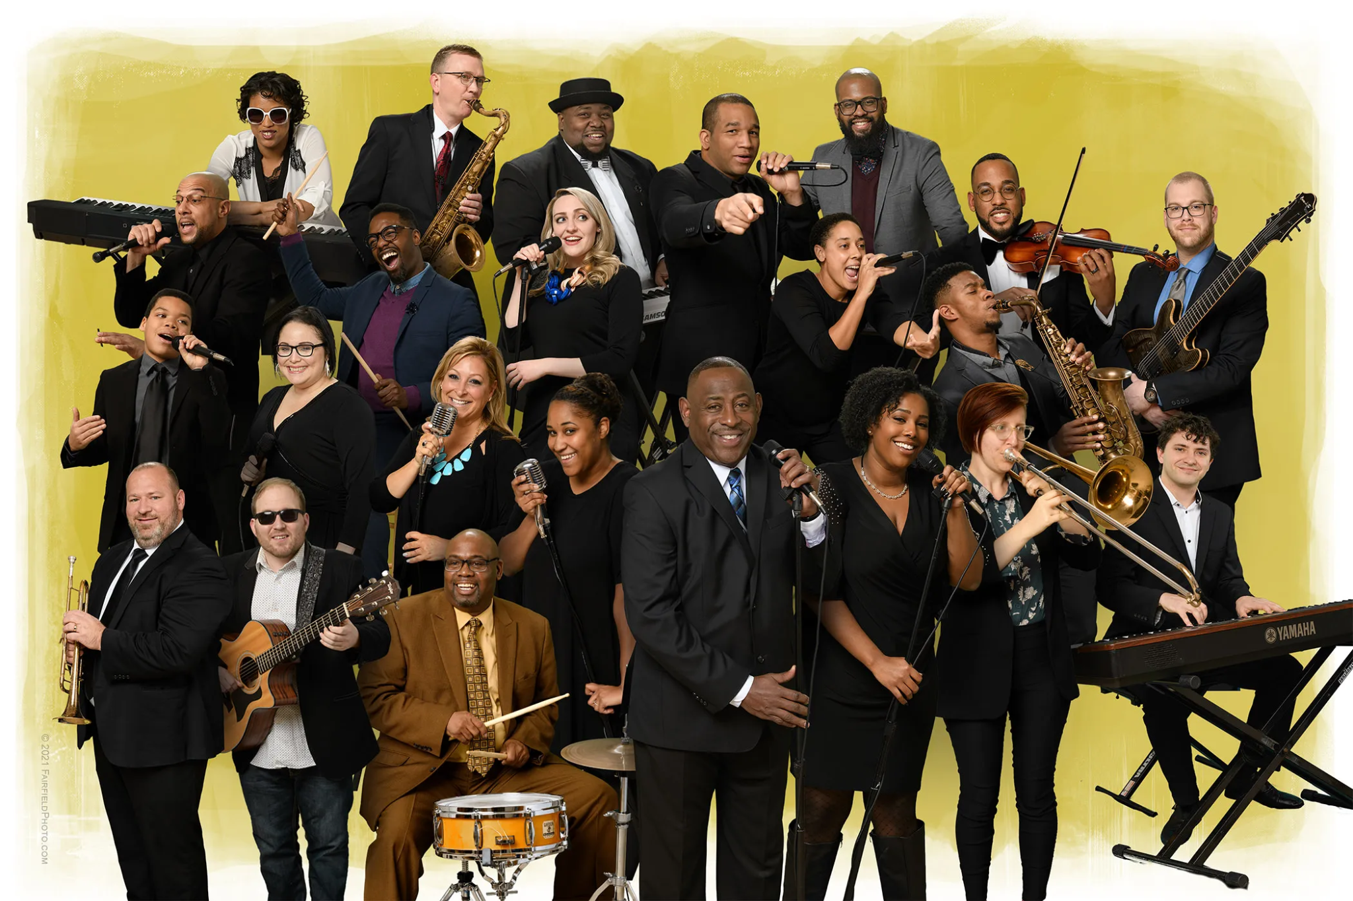
Project Summary
Service that matches individuals via career goals and/or taste in music
Plans to utilizes popular music streaming service analytics
Plans to utilize record charts

Slide 4
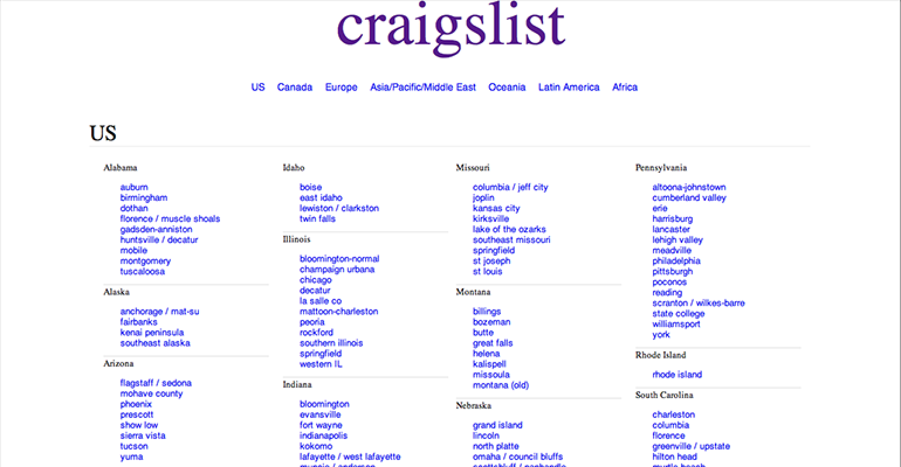
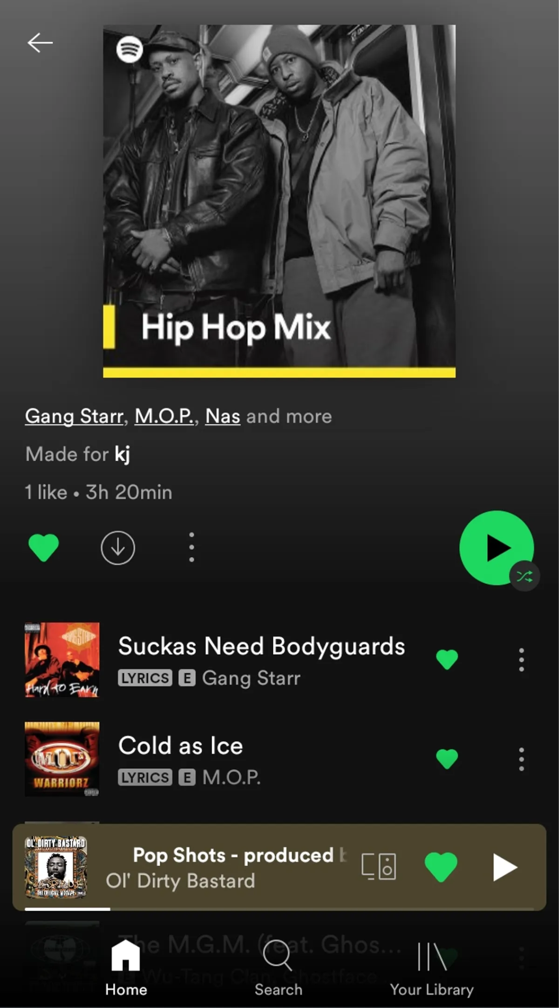

Background Section (Optional)
Our group members have a mutual appreciation for social apps (i.e. Vine, Instagram, Spotify, Tinder, etc).
Decided to make a matching app for music lovers/musicians

Slide 5
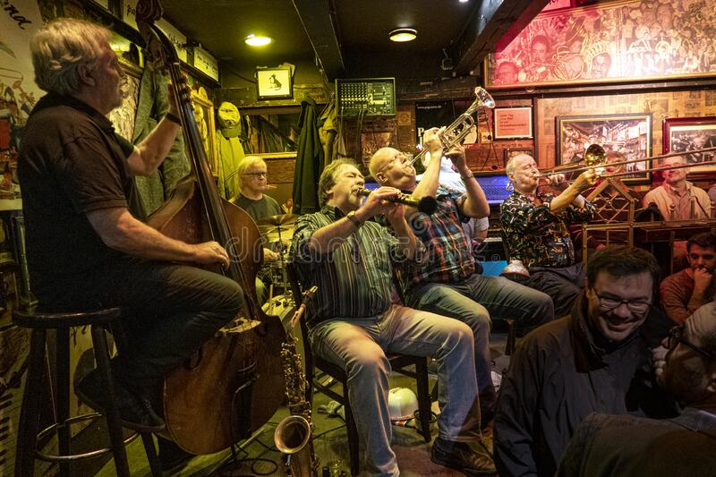
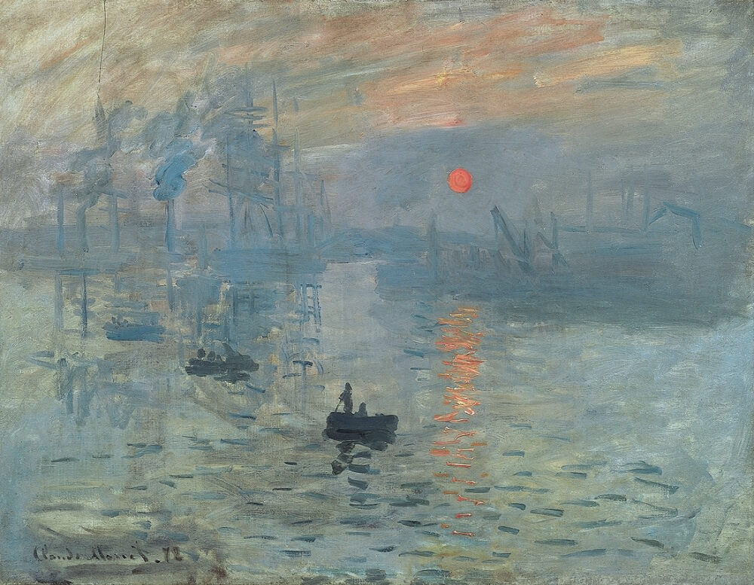
Project Importance
Art and creation drive the human experience.
Part of that experience is sharing music, and our love of it with others.

Slide 6
Project Impact
Links CSUN Students and potential creators.
Potential creation of true works of art
Connecting strangers through music.

Slide 7
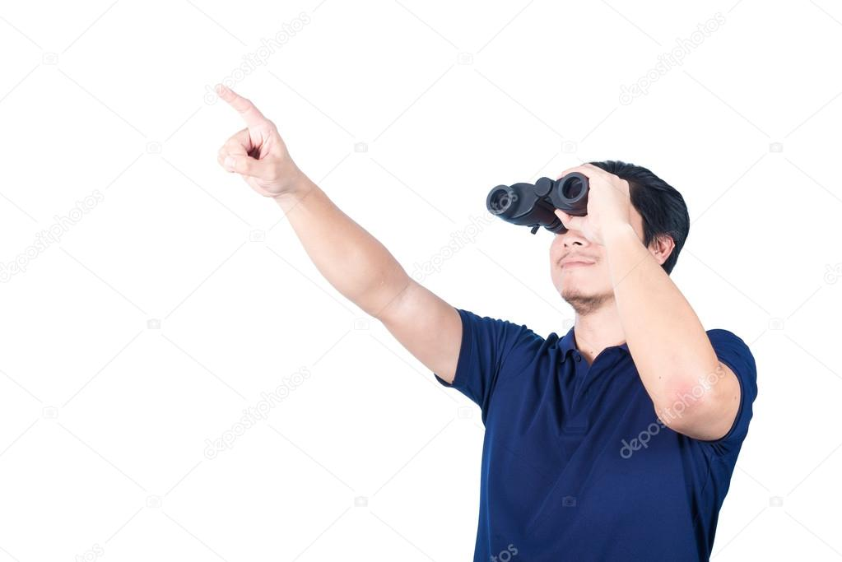
Project Approach
Create code to analyze factors such as, age, distance, music, etc to link together individuals and creators of similar goals. Afterwards, we will focus on creating an efficient but intuitive UI.

Slide 8


QUESTIONS??????????

